Slide 1
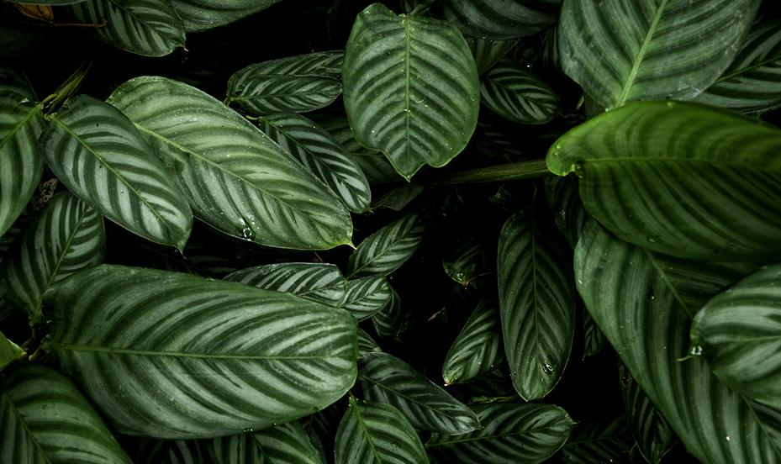
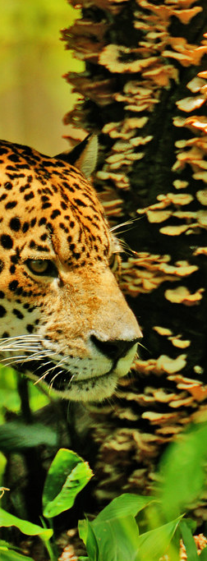
THE FUTURE OF BRAZILIAN CERRADO

Slide 2
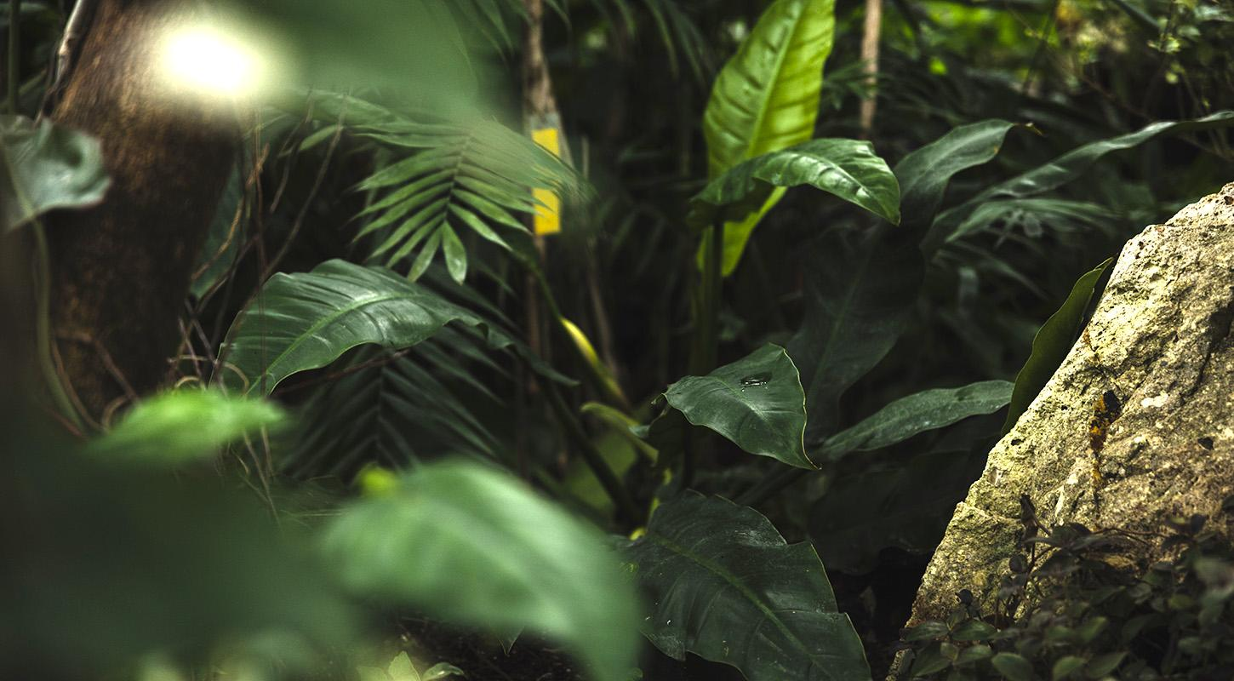
01
BIOMES

Slide 3
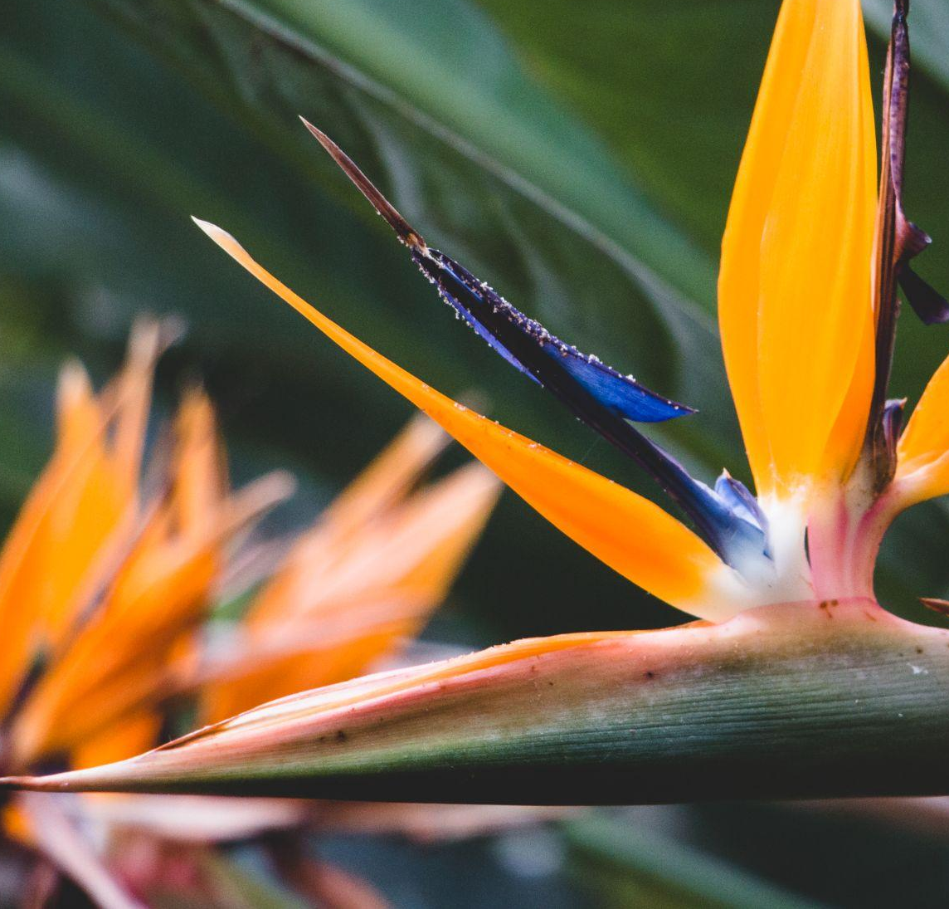
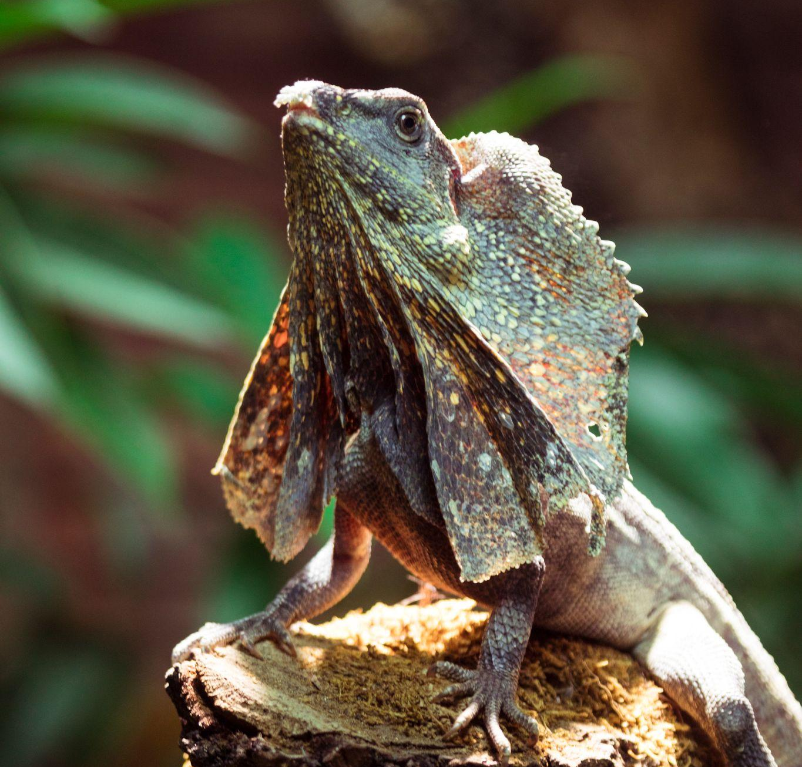
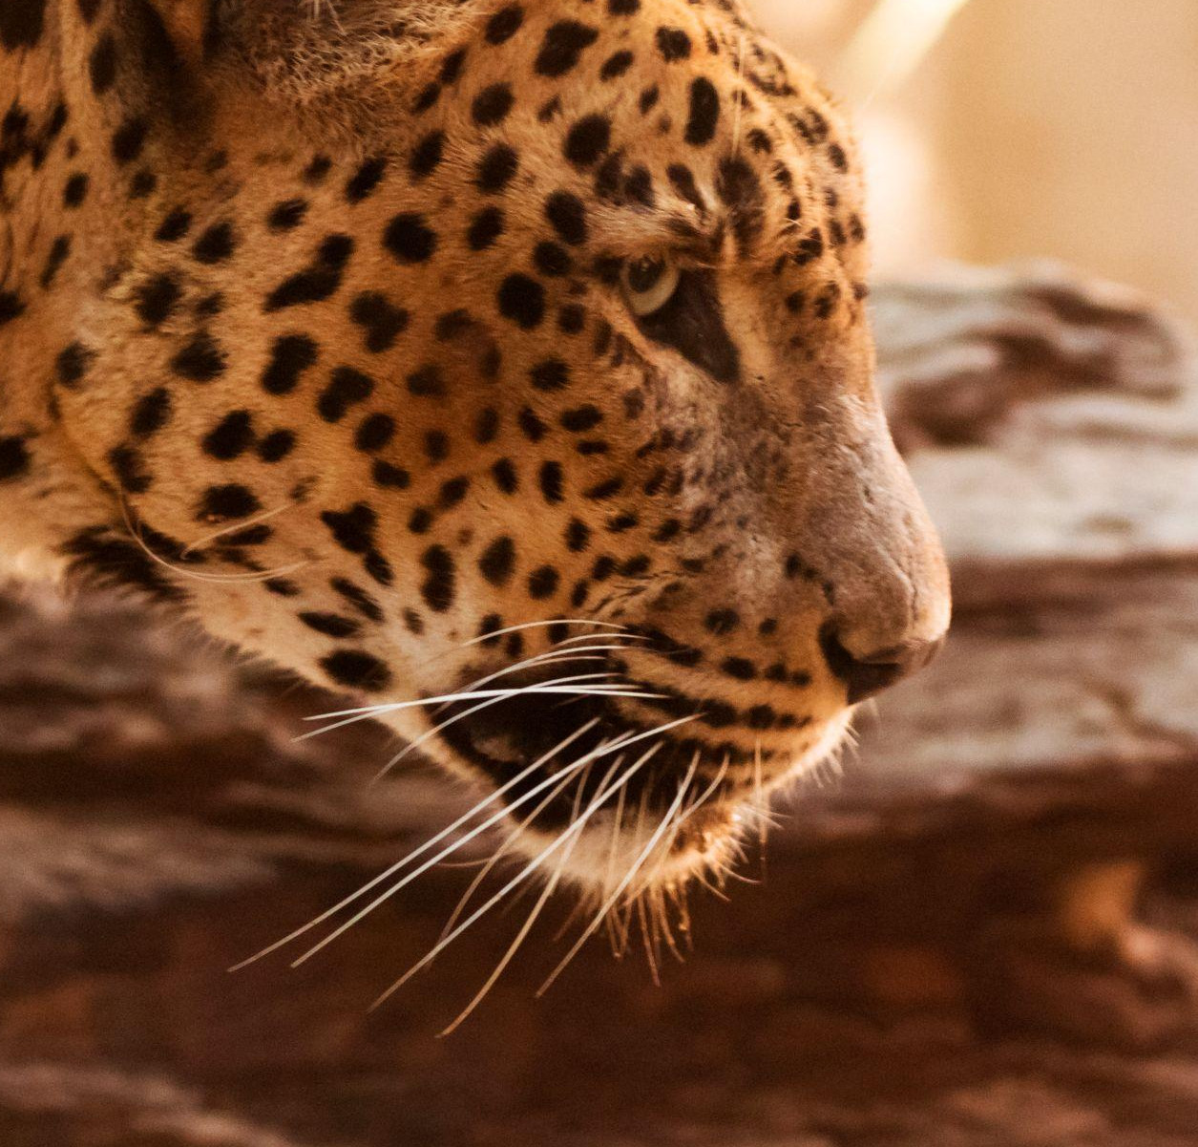
AMAZON VS CERRADO
AMAZON
CERRADO
3.5% of Earth’s land yet
home to 1 in ten, 10%, of
all the known species
Size of the forty-eight contiguous United States
VS
2nd largest vegetation type
in Brazil after the Amazon
& world’s biggest savannah
Size of England, France,
Germany, Italy & Spain
6.7 mill km² : 2 mill km²
40 % of Brazil: 21% of Brazil
10%: 5%
1 In 10 : 1 In 20
of Earth’s Species
Notes:
Including critically endangered species.

Slide 4
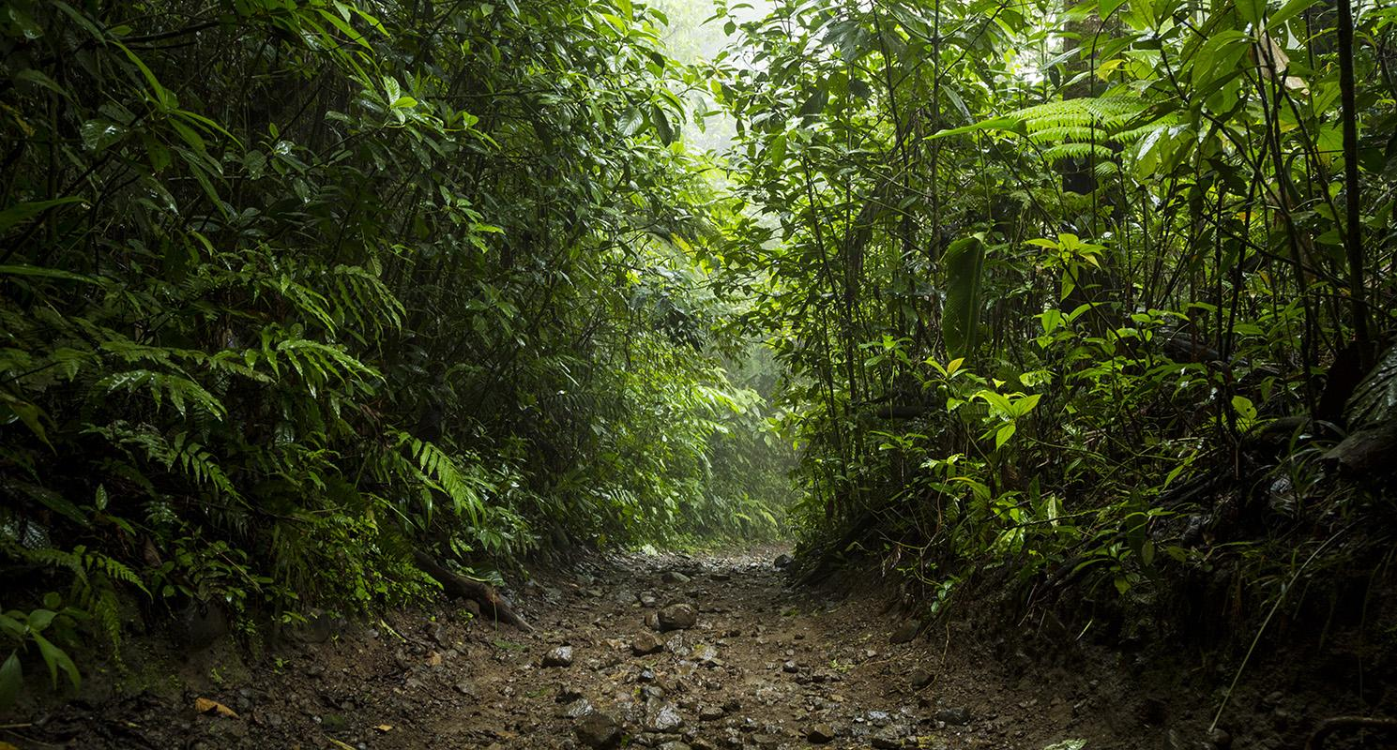
BENEFITS FOR EVERYONE
15%
20%
70%
CLIMATE CHANGE
OXYGEN
WORLD HEALTH
of greenhouse gas emissions are from deforestation. Tropical Forests are also carbon sinks of 228+ gigatons, 7x that emitted by humans.
of the world’s oxygen is produced by the trees of the Amazon.
of the plants identified with anti-cancer characteristics are found only in the rainforest. 121 prescription medicines are plant-derived.
Notes:
Carbon sinks which release carbon into the atmosphere from their cut roots in the soil. Emitted by humans each year.

Slide 5
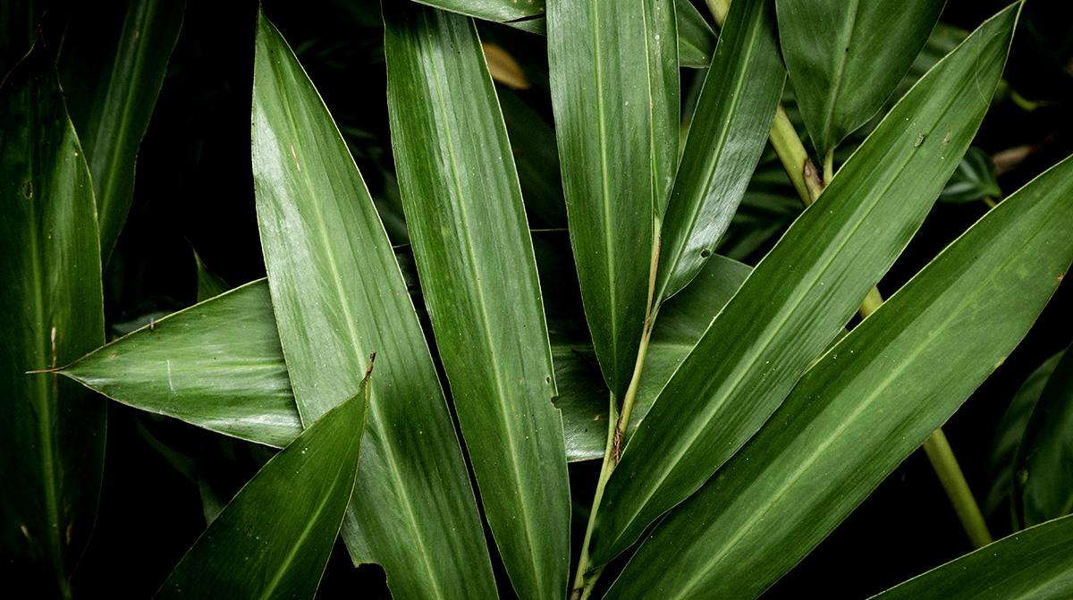
DEFORESTATION
02

Slide 6
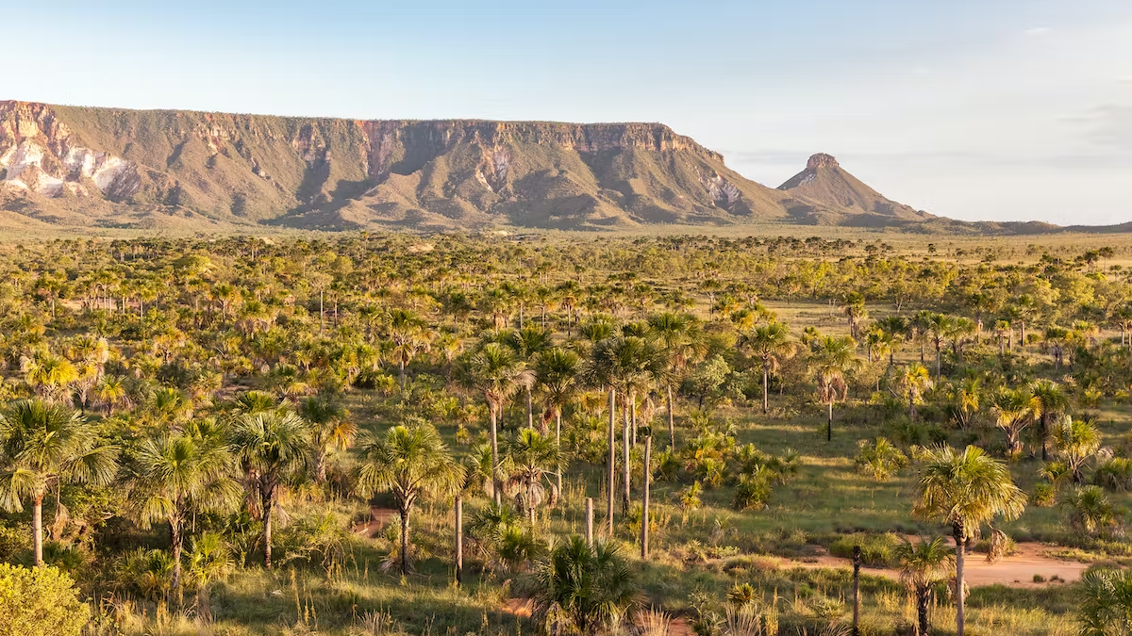
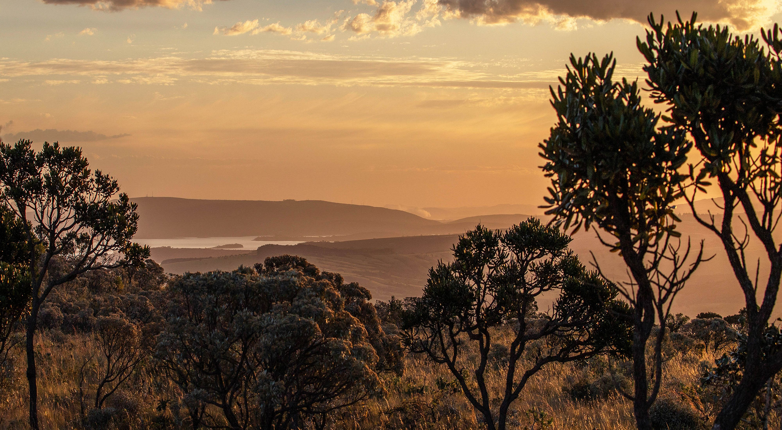
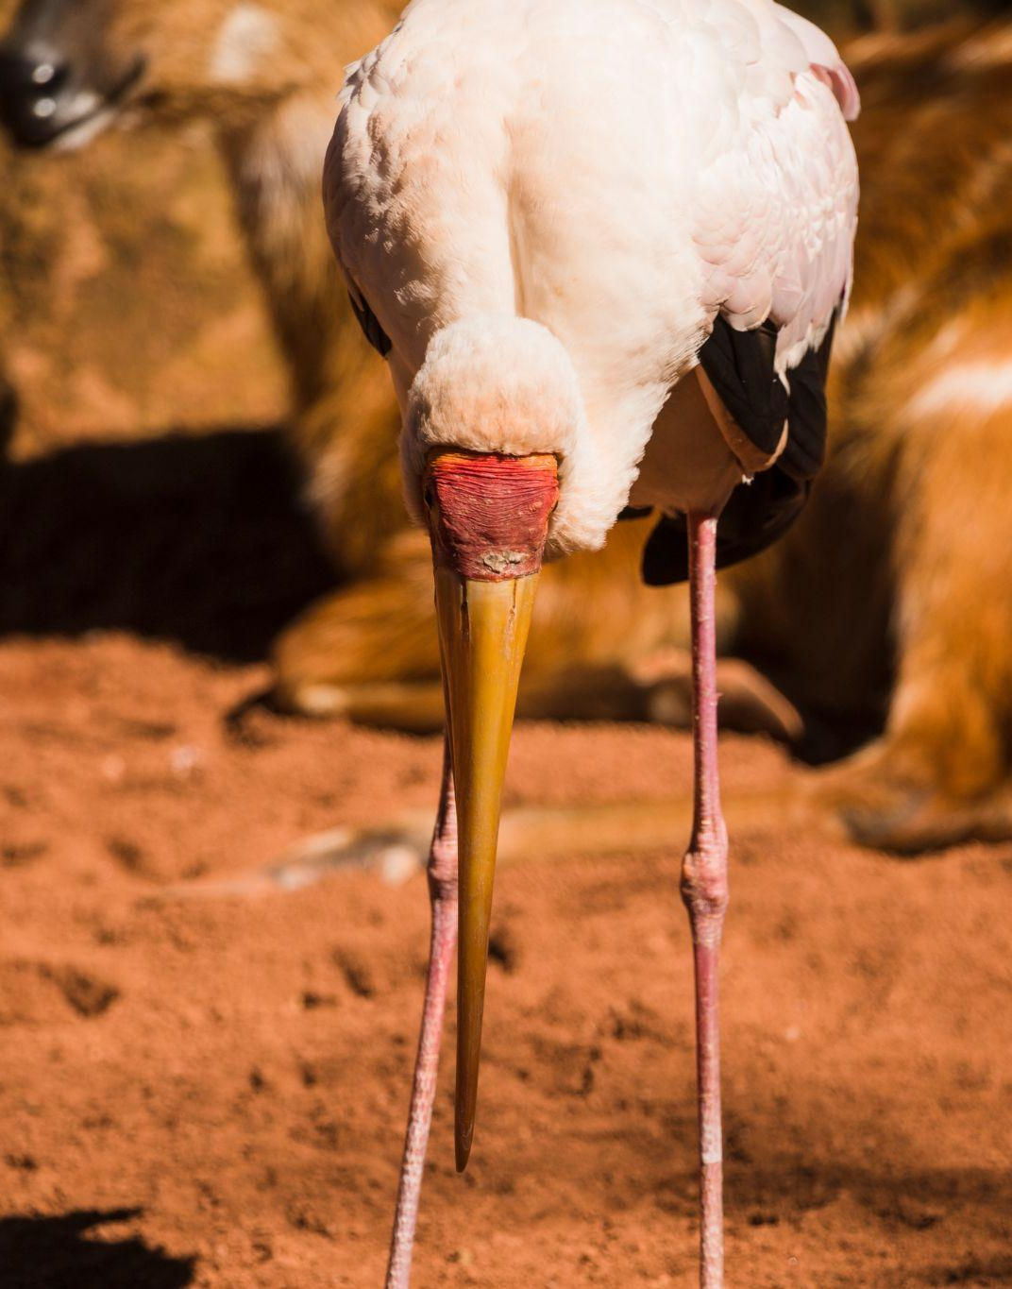
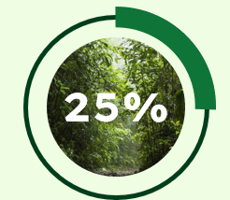
297 790km2
8339km2
2001-2022 Total Deforestation
2021 Total Deforestation
10445km2
INCREASE
2022 Total Deforestation
Notes:
For CERRADO. This highly valuable landscape, which has never received the same attention as its more celebrated neighbor, the Amazon, is being destroyed at a frighteningly fast pace

Slide 7
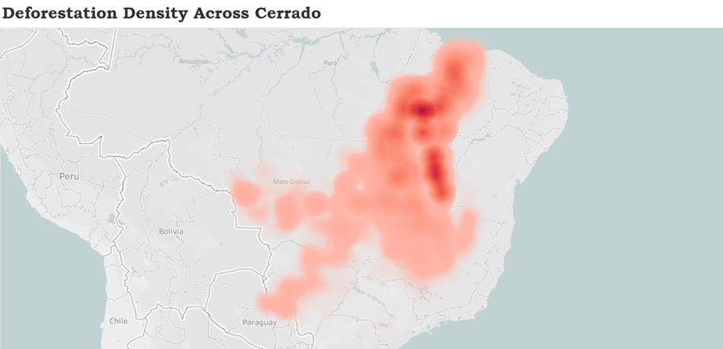
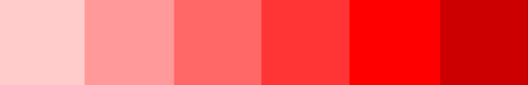
2022
Density Medium- High
Notes:
Devastation. The deeper the red the higher the density of deforestation.

Slide 8
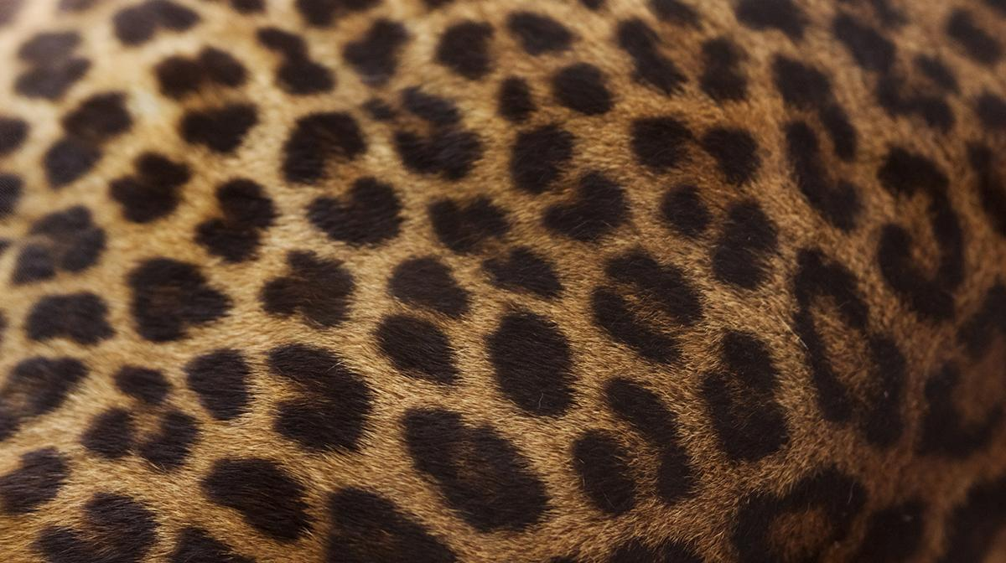
03
FUTURE
Predicting The Future

Slide 9
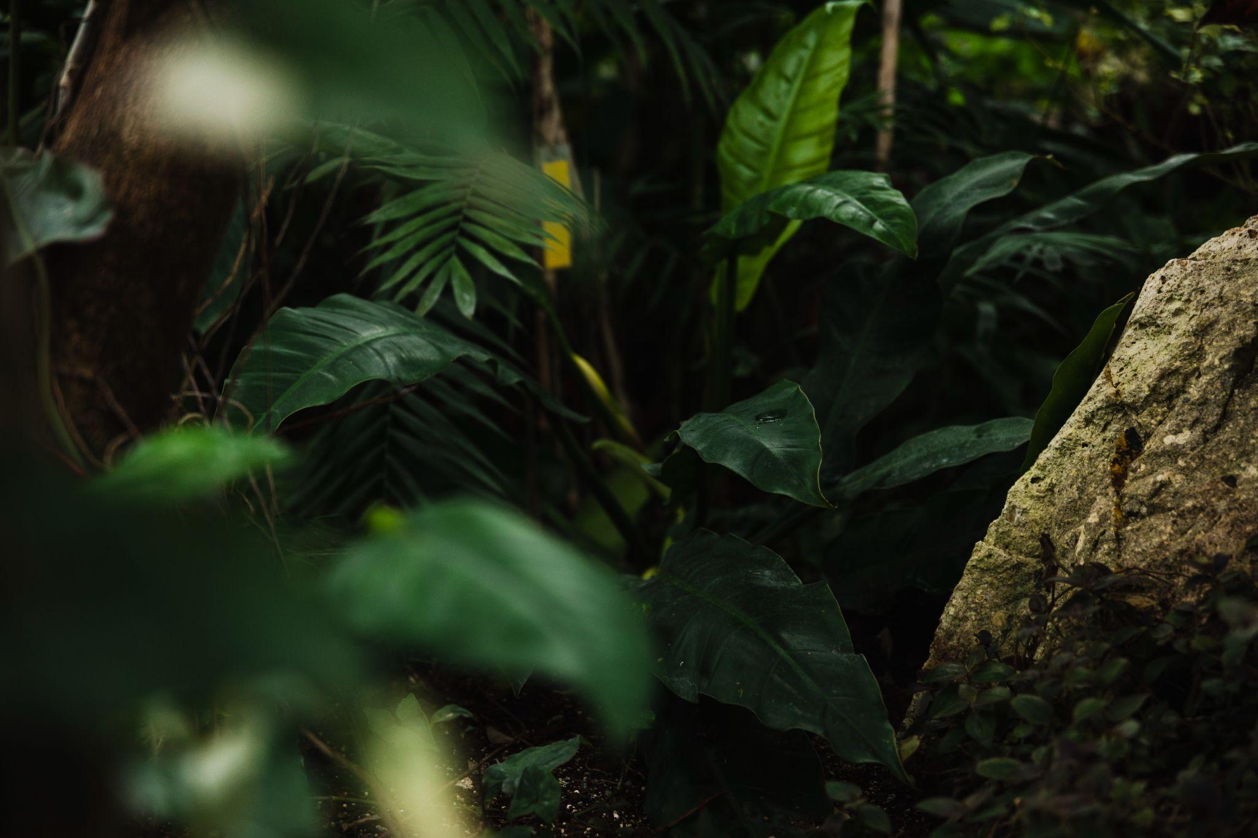
From 2024, the EU will require firms working in deforestation hotspots to certify that certain goods have not harmed forests.
Notes:
FOR THESE PRODUCTS, and does not protect the amazon from being ravaged by the rest of the world.

Slide 10
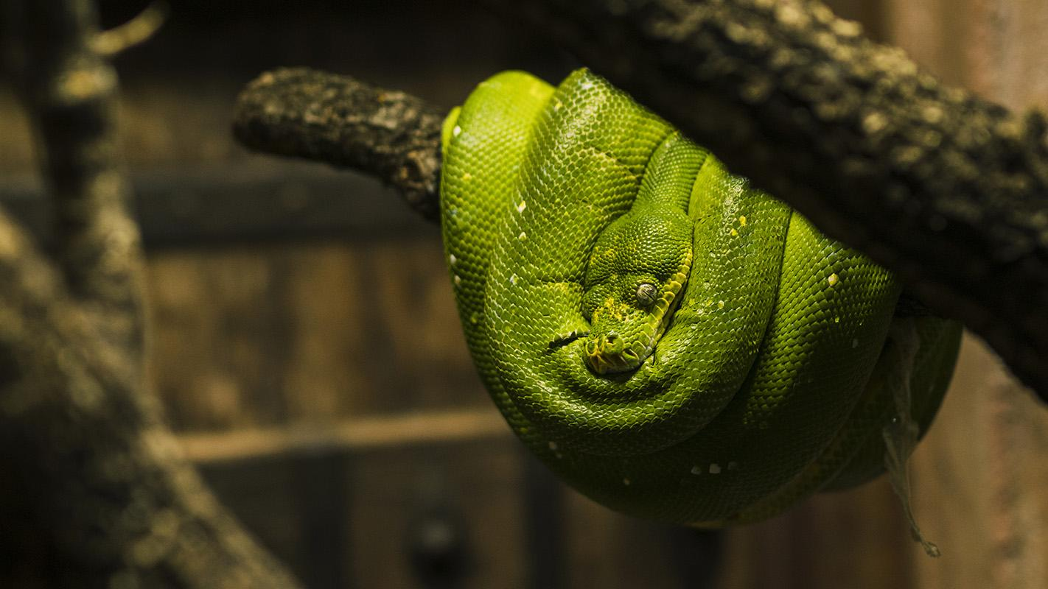
10% of Brazilian Exports: EU
According to the EU, Forest is defined as:
Land spanning at least 0.5 ha, with trees higher than 5m and a canopy cover of at least 10%.
Notes:
They debated and some may have fought whilst some will have seen dollar signs and deals in their eyes when they came up with finally concluded on this law having this definition of forest. This will disclude many other areas and Cerrado which are deforested and ravaged by both the EU and the world. Only 20% of the original vegetation remains; less than 3% of the area is currently protected by law.

Slide 11
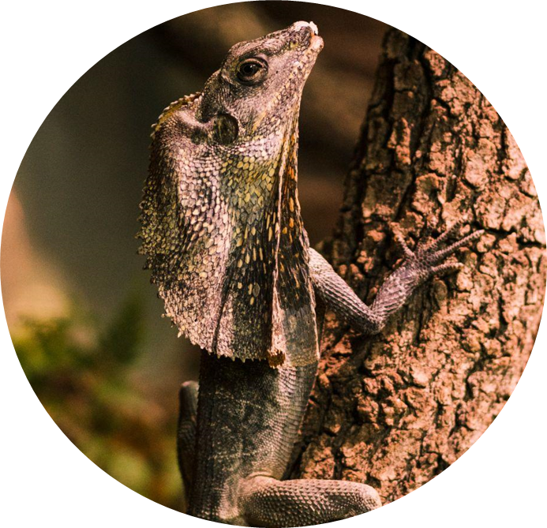
EUROPEAN UNION
Law should have been discussed but did not due to Covid
Time for companies to adapt
2020
2023
2022
2024
In December the Law was finally passed
Law will be fully applied and other biomes discussed

Slide 12
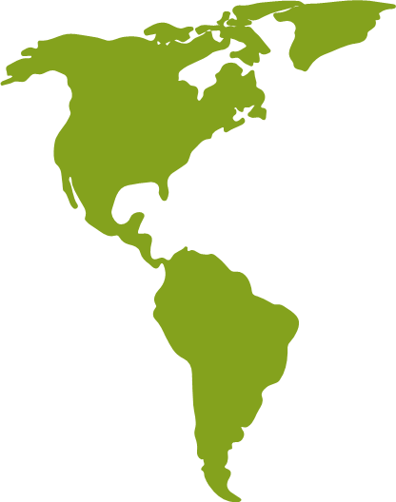




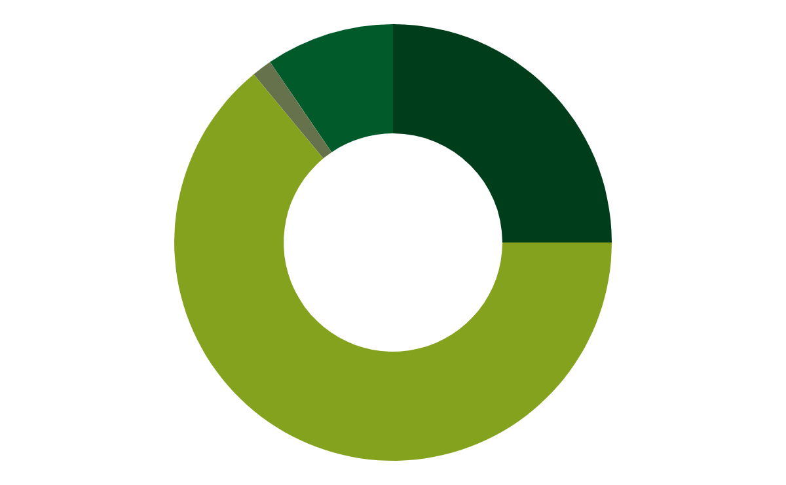
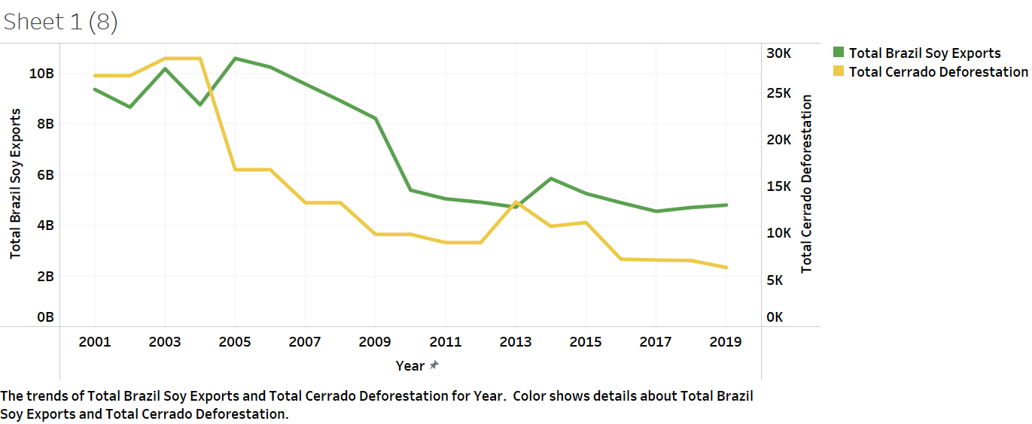
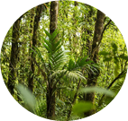

BRAZIL EXPORT 2022 TOTALS TO EU
2789084 t
25%
COFFEE
2789084 t
9.5%
SOY
1.5%
164653 t
CATTLE/MEAT
7119229 t
WOOD
64%
Balsas City 2022
1st in Deforestation
6th in EU Soy Exports
Notes:
Our data analysis has shown that these exports have a relationship to deforestation as highlighted by the graph, they even help to predict the future of deforestation. – how many years. These are affected by the law.

Slide 13
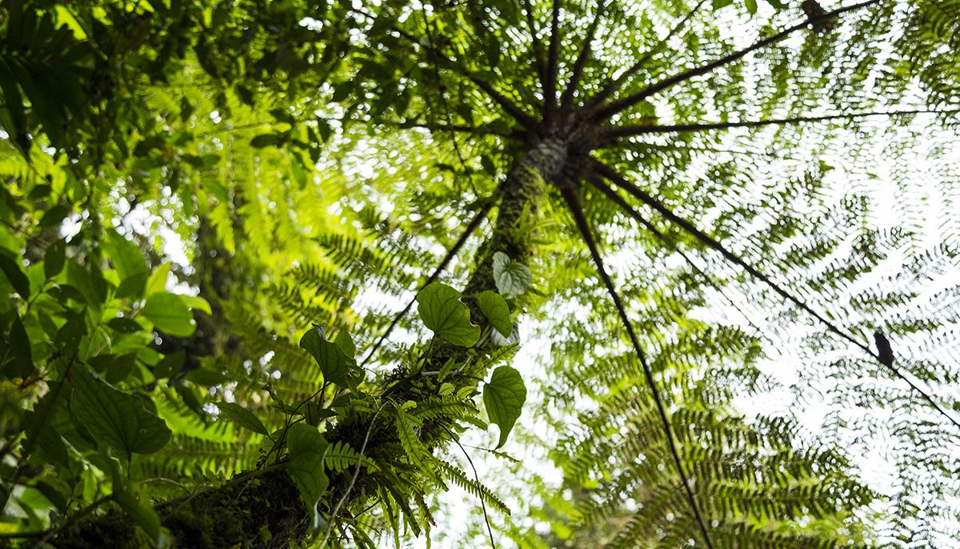
805 milliontonnes
2019 Total Cerrado Greenhouse Gas Emissions due to EU Law included exports: Coffee, Soy, Palm Oil, Cattle/Meat, Wood, Rubber & Cocoa in 2019

Slide 14
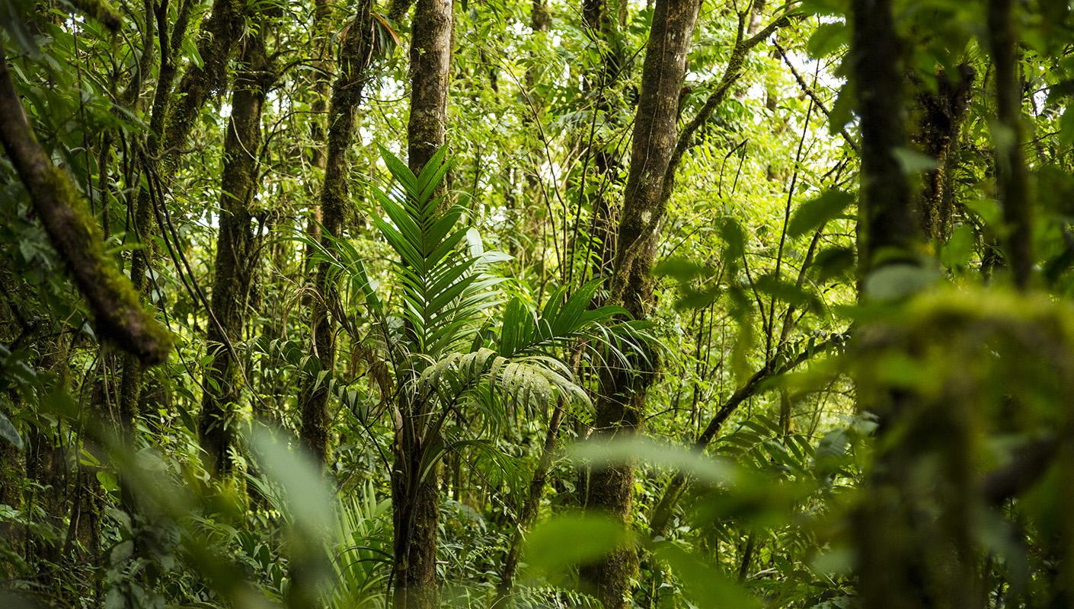
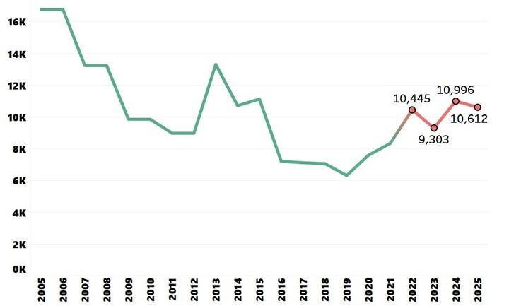
MODELLING THE PREDICTED FUTURE
Notes:
16,000 square kilometers

Slide 15
PREDICTED FUTURE
9303km2
predicted deforestation in 2023
30 911km2
predicted deforestation from 2023-2025
Notes:
This is without the law as it does not protect Cerrado,

Slide 16
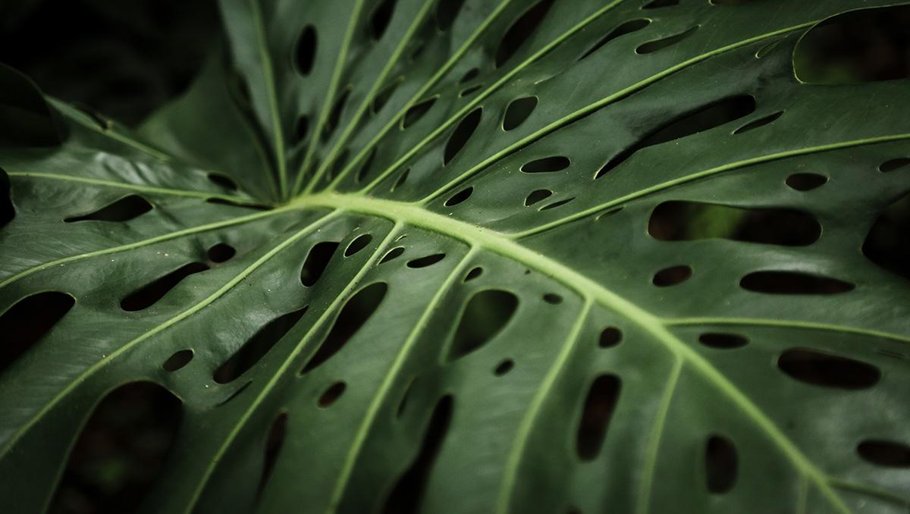
Without the Cerrado & the Amazon, we lose the fight against climate change

Slide 17
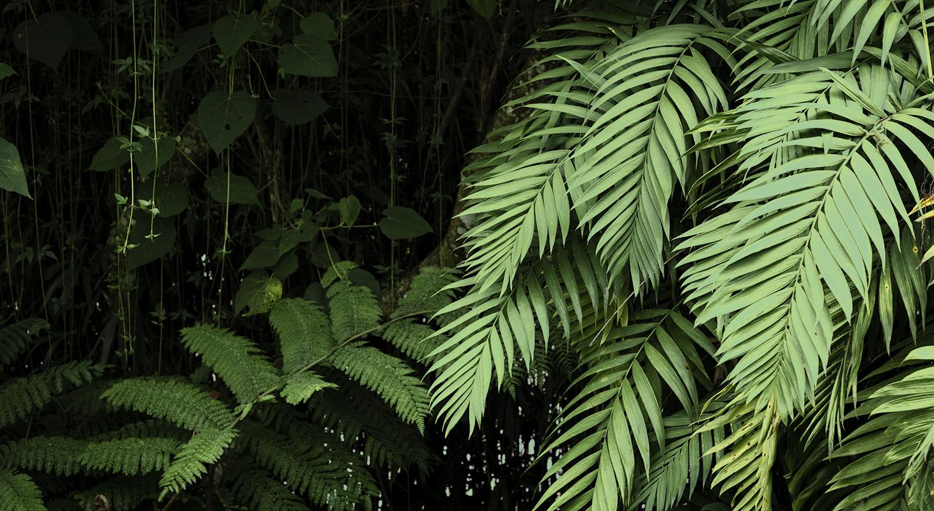
04
WHAT YOU CAN DO

Slide 18
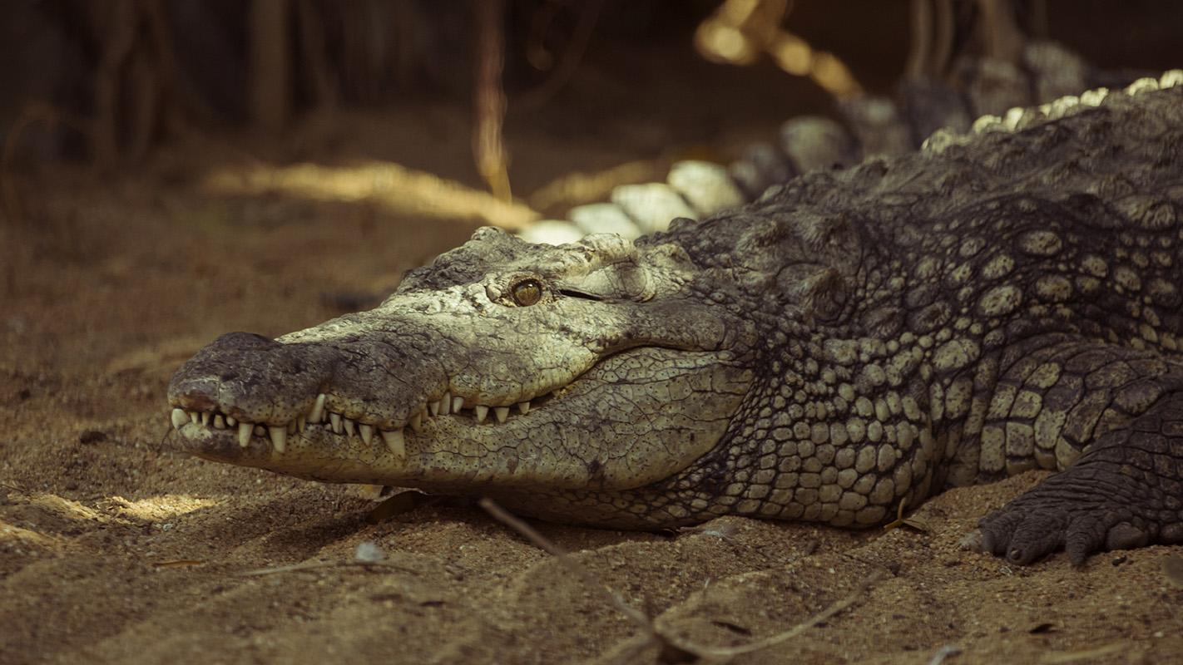
Just 14 global agriculture companies have the power to save it by ending deforestation and conversion in their supply chains by 2025. If not, this critical habitat, water source, and carbon sink may be lost forever—putting a livable climate and global food security in jeopardy.
Notes:
To save the tropical and sub tropical biomes of Brazil.

Slide 19
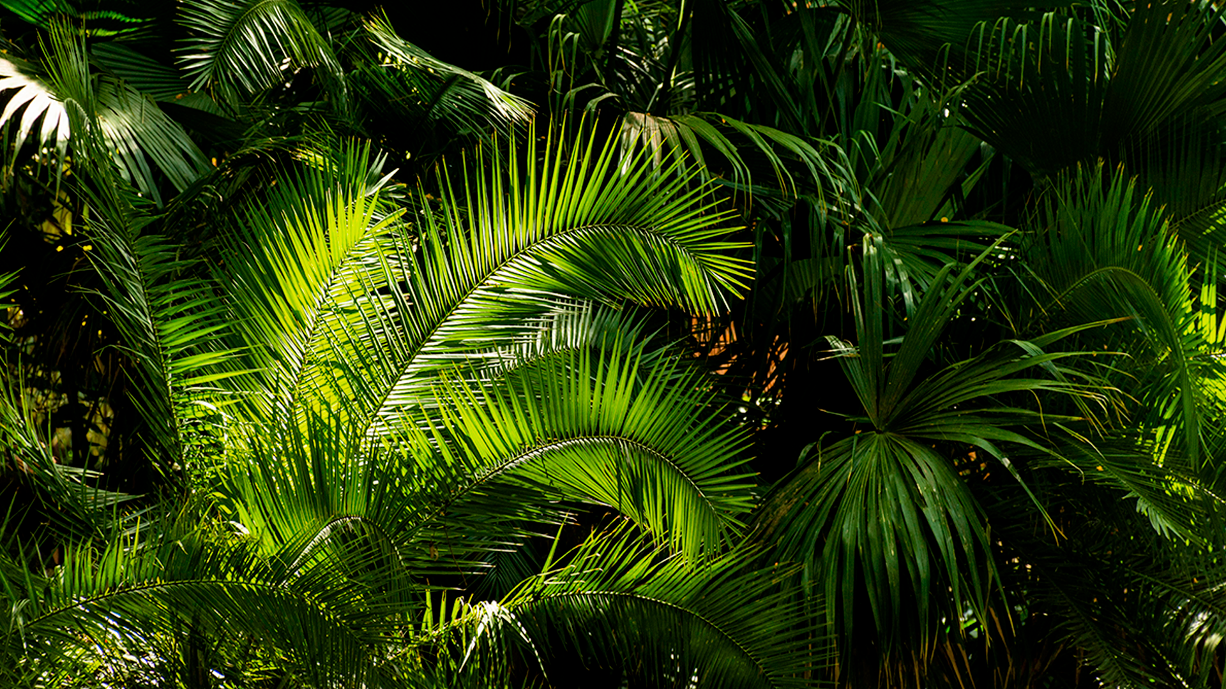

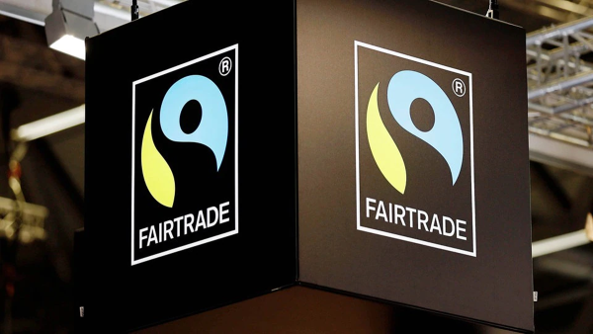
FAIR TRADE
A label of products which:
Ensures sustainability whilst monitoring deforestation and assessing environmental vulnerability
:

Slide 20
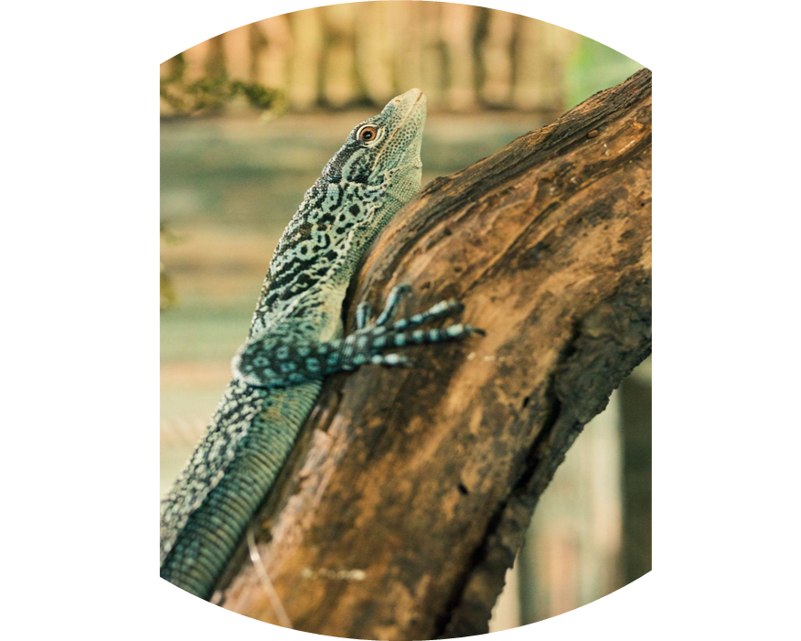
FAIRTRADE & WORK RESOURCES
Fairtrade Store & Product Lists
Online-Shoppingliste: Fairtrade Deutschland
(fairtrade-deutschland.de)
Fair Trade Gifts & Accessories - The FAIR Trade
Store Produkt-Finder: Fairtrade Deutschland
(fairtrade-deutschland.de)
Data Analysis Job Position Areas & Topics
Unsustainable Agricultural Expansion
Food Engineering
Fairtrade Product Identification
Species Identification

Slide 21
OTHER HARMS OF DEFORESTATION
DISRUPTION OF WATER CYCLES
INHUMANE TREATMENT
Water cycle’s trees keep balance between the water on land & the atmosphere, resulting in changes in precipitation and river flow.
1.25 billion people around the world rely on forests for shelter, livelihoods, water, fuel, & food security. The Cerrado is home to 25m, where 200+ tribes live traditional lives. Poor people have been lured from their villages to remote soy plantations where they may be abused and forced, at gunpoint, to work under inhumane conditions.
SOIL EROSION
Trees anchor fertile soil, or erosion can sweep the land into rivers. Agricultural plants that replace trees cannot hold the soil. Estimated that a 3rd of the world’s arable land has been eroded & degradated since 1960.

Slide 22
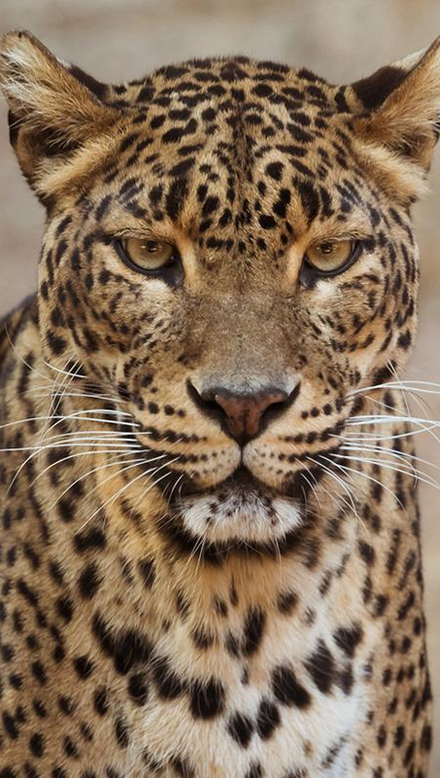
HOW TO GET INVOLVED
HOW TO GET INVOLVED links
What can you do to support the embattled defenders of the Amazon, and indigenous rights more broadly?
Support the work of Amazon Watch – they are supporting local efforts in the Amazon, and providing in-depth research looking at the global supply chains and the corporations and financiers who are responsible.
Sign the petition to stop BlackRock—they are one of the largest investors in Brazil’s agribusiness industry, and their financial backing is key to the continued destruction of the Amazon.
Join local actions in your community—find a community event for the Global Day of Action for the Amazon on September 5th.
Support the Real Meals Campaign—we are calling on Aramark and the big cafeteria companies to drop their allegiance to Big Food and invest in a food system that is fair, humane, ecologically-responsible, and grounded in racial justice.
Support indigenous rights where you live—lookup whose lands you are on and educate yourselves on the issues faced by indigenous communities where you live.
Read up on other economic models—fair trade farmers, their cooperatives, and fair trade enterprises around the globe are just of a few of those who have been experimenting with community-based, solidarity economics over the past decades.
-WWF

Slide 23
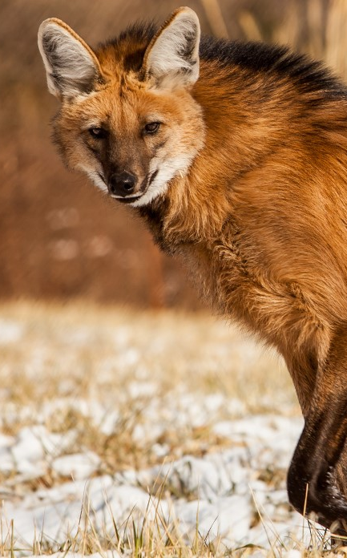
THANKS!
Do you have any questions, or would like to collaborate with us?
Contact us at:
nevin.poppy@outlook.com
pedrorpp10@gmail.com
REFERENCES:
WWF| Link - Learn about the Amazon rainforest | WWF
US National Cancer Institute| https://dtp.cancer.gov/organization/npb/introduction.htm
MapBiomas| "MapBiomas Project- Collection [7 AND LEGEND DESCRIPTION] of the Annual Series of Land Use and Land Cover Maps of Brazil, accessed on [04.03.2023] through the link: [https://mapbiomas.org/en/colecoes-mapbiomas-1?cama_set_language=en]"
"MapBiomas Project - is a multi-institutional initiative to generate annual land use and land cover maps from automatic classification processes applied to satellite imagery. The full description can be found at http://mapbiomas.org".

